Slide 1
Linux Files, Directories Basic Commands 1 Lab -3
Submitted by: Sandesh Chaudhary
Roll No.: 21111009

Slide 2
Table of Contents
1. cd , ls
2. cp
3. rm
4. mkdir
5. rmdir
6. pwd
7. file
8. more
9. less
10. cat
11. chmod
12. chown

Slide 3
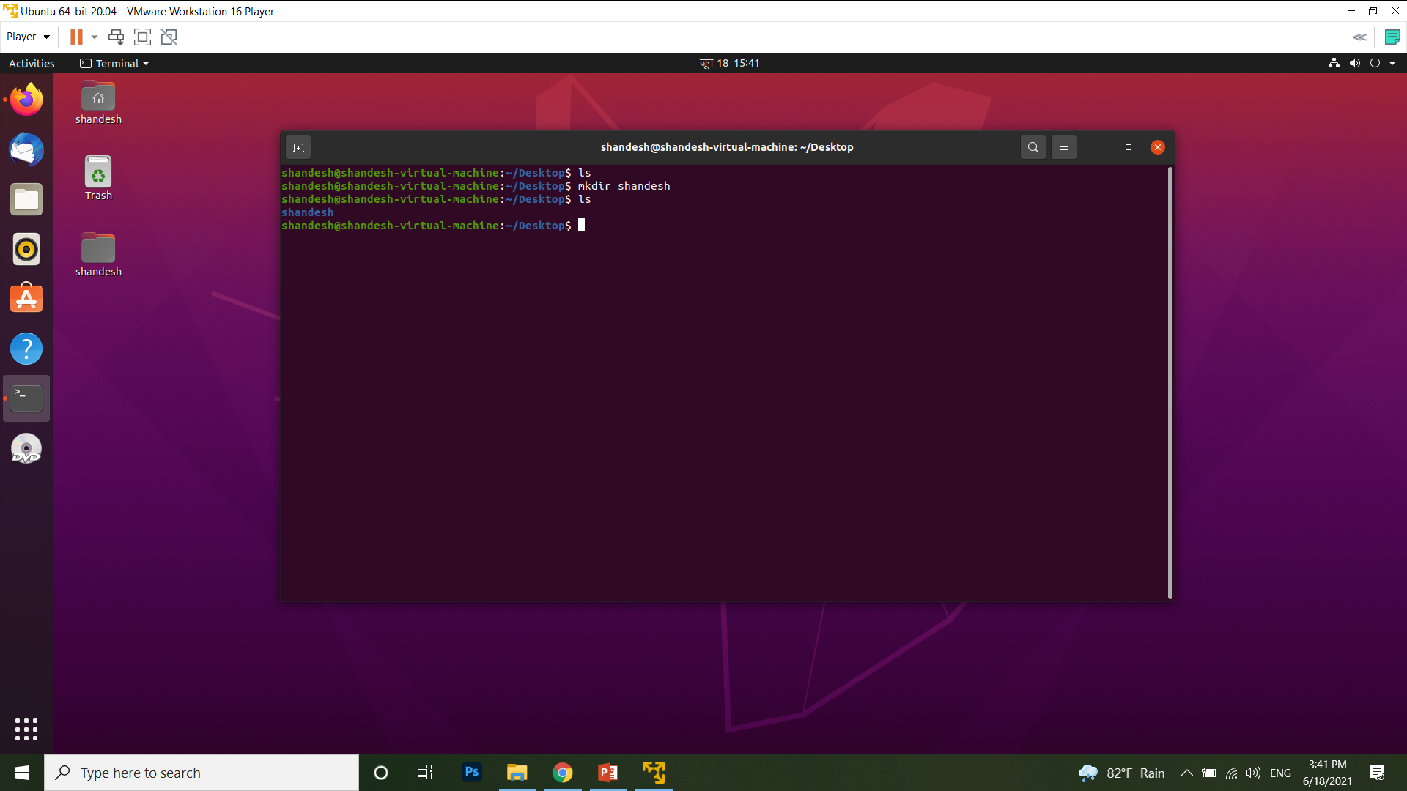

Slide 4
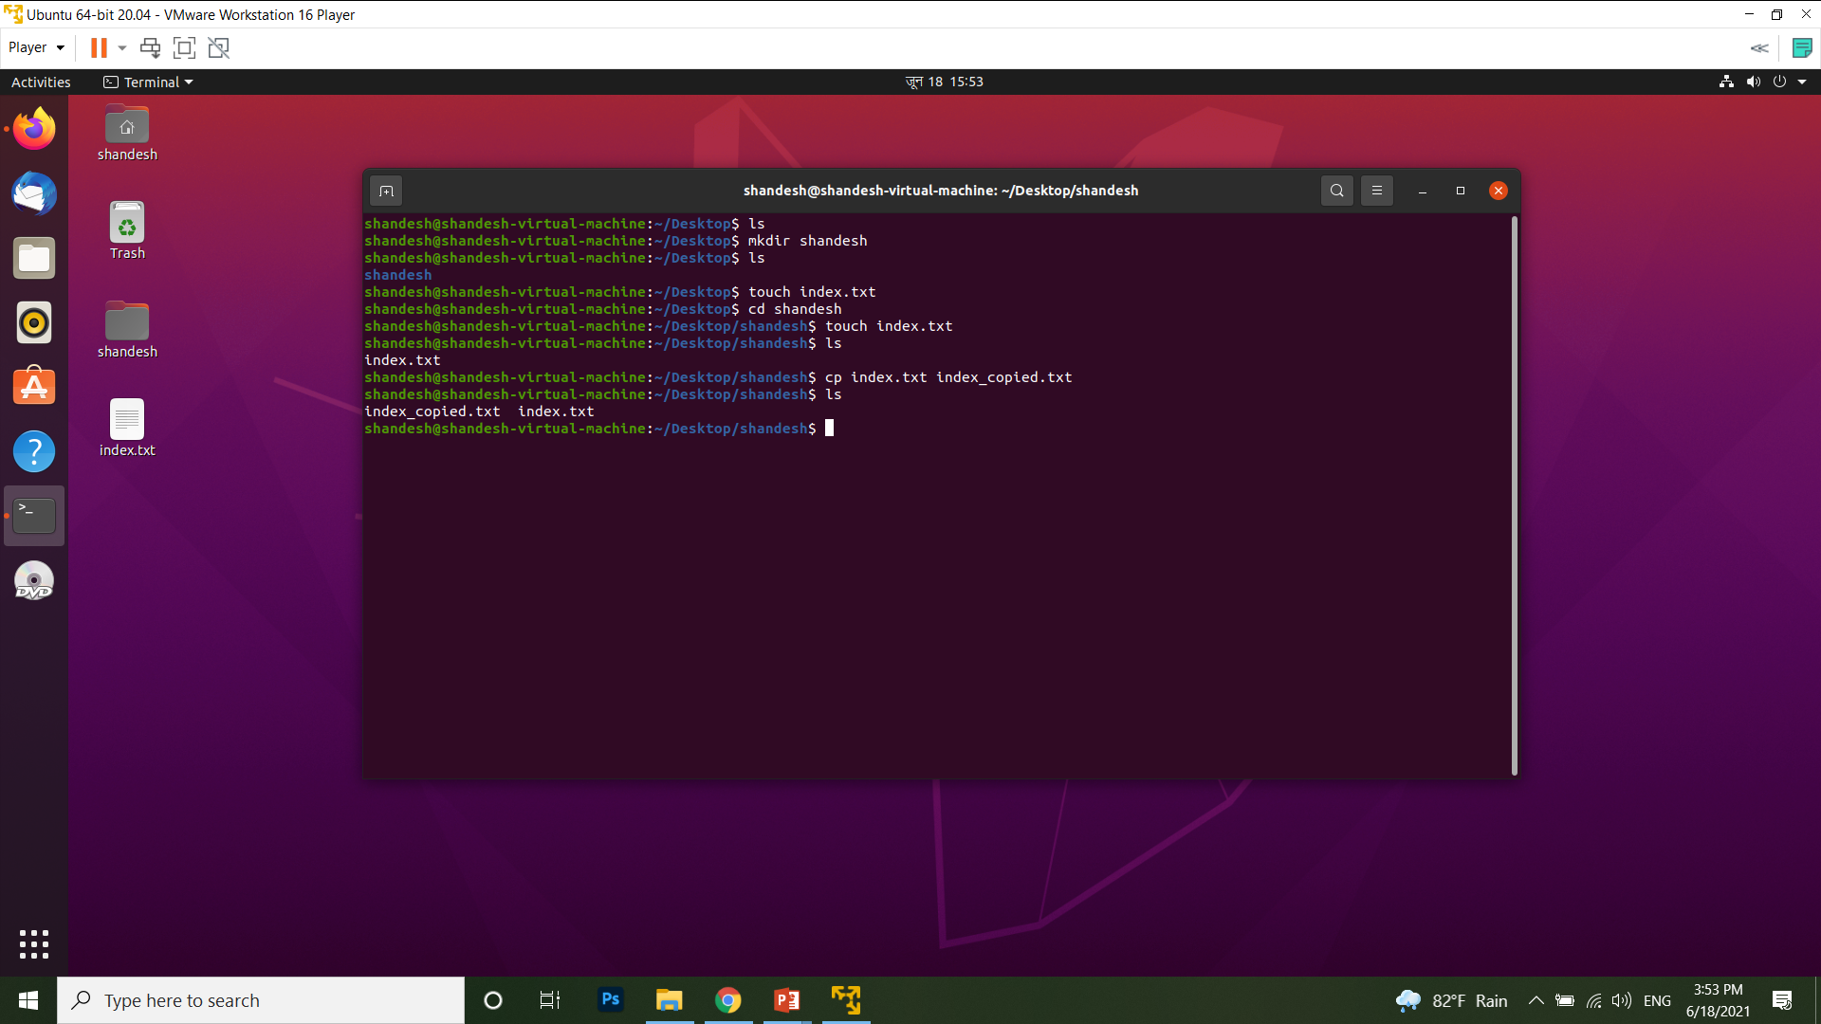

Slide 5
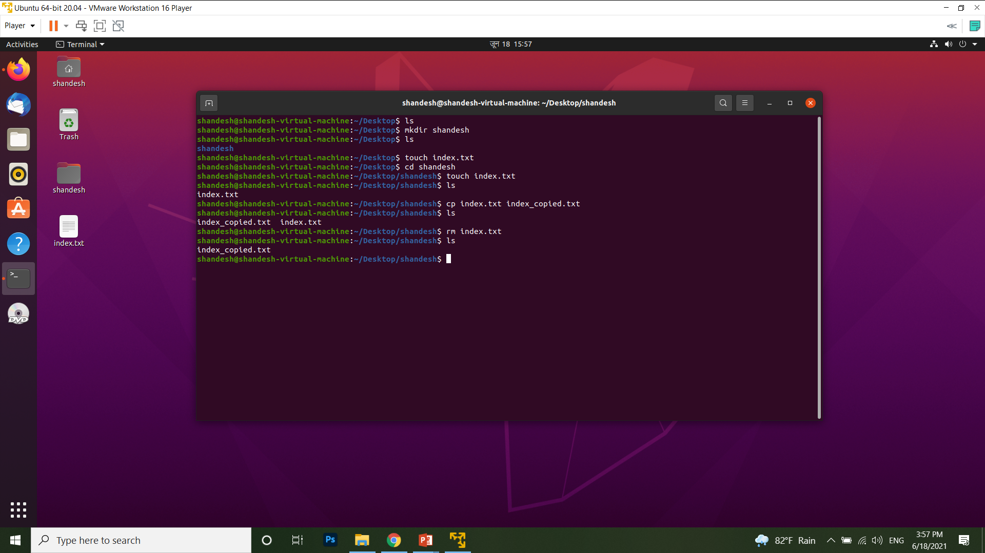

Slide 6
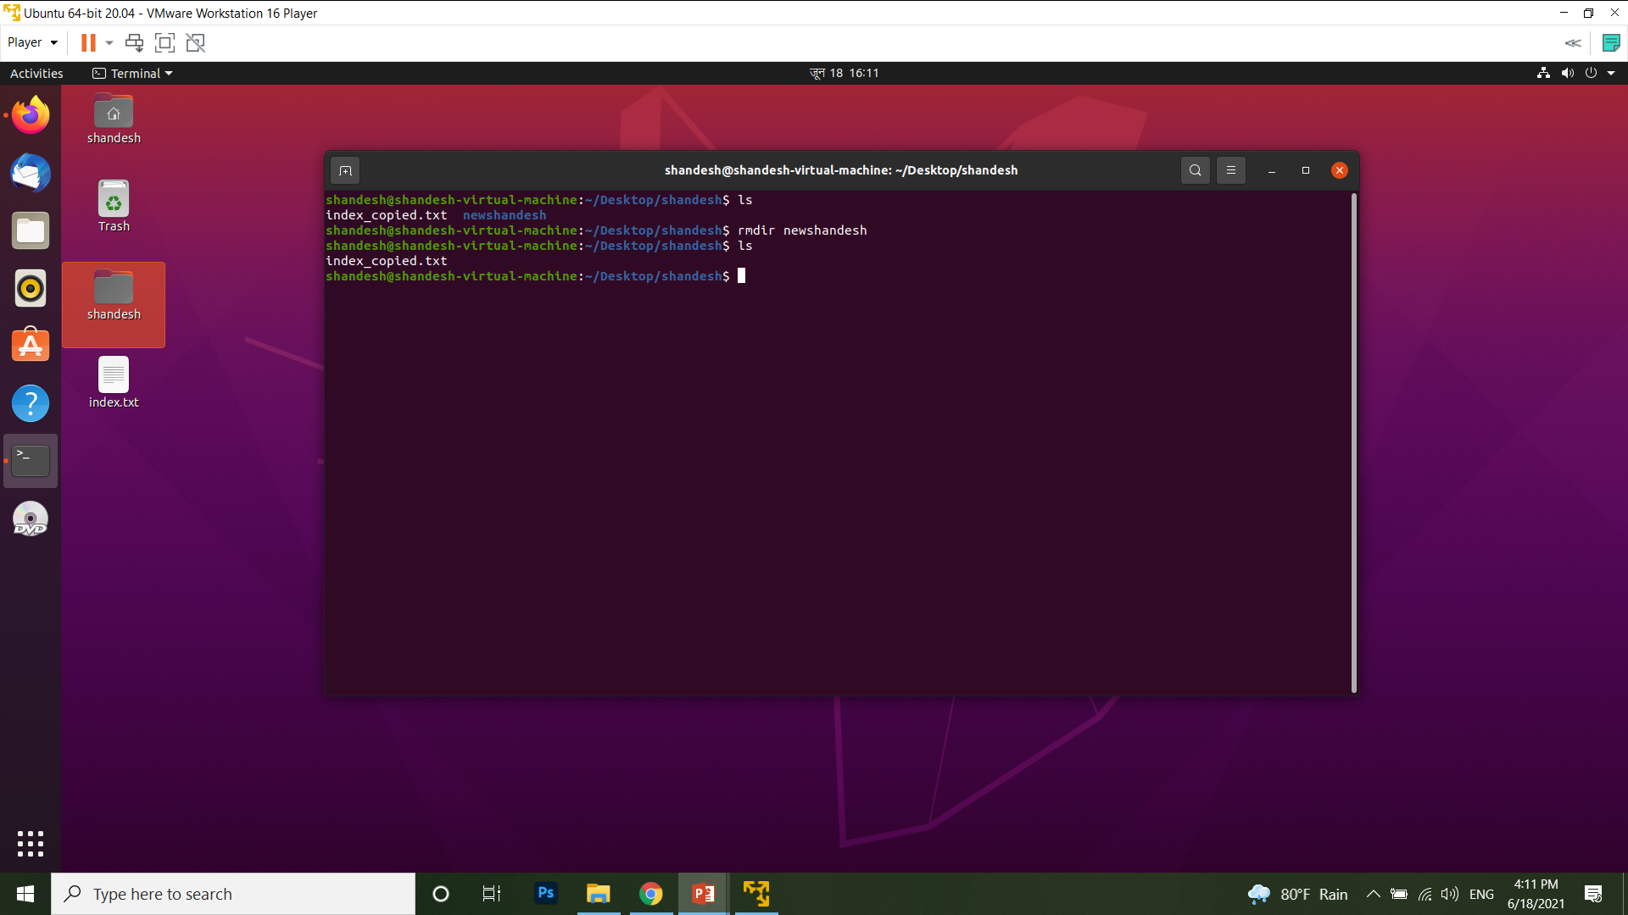

Slide 7
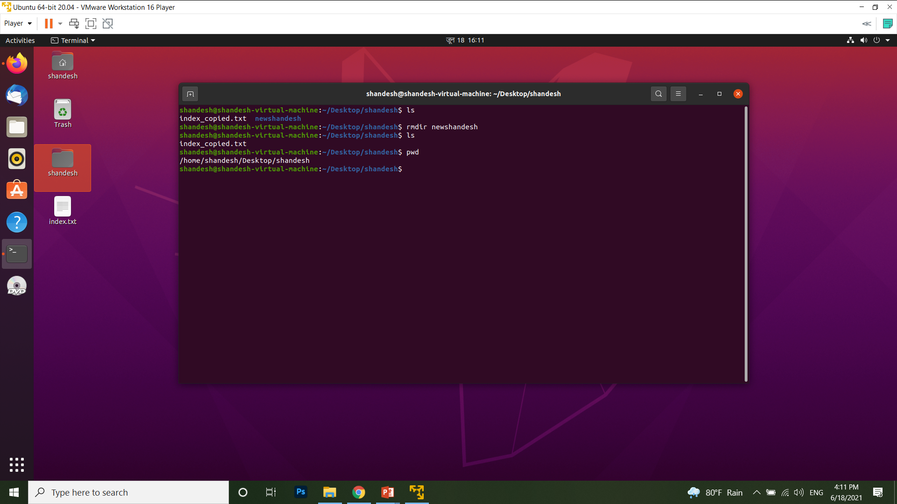

Slide 8


Slide 9


Slide 10
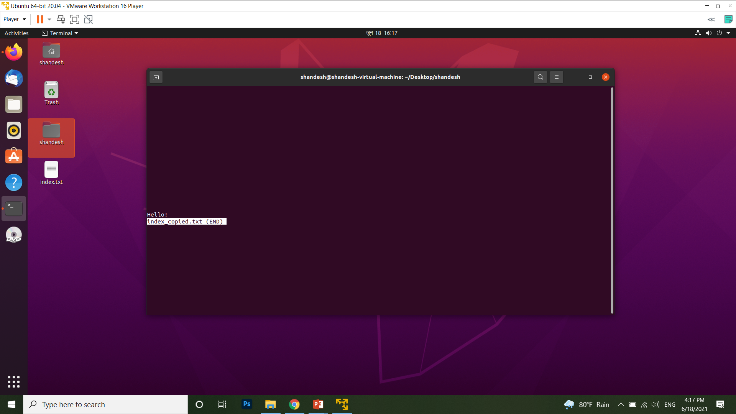

Slide 11
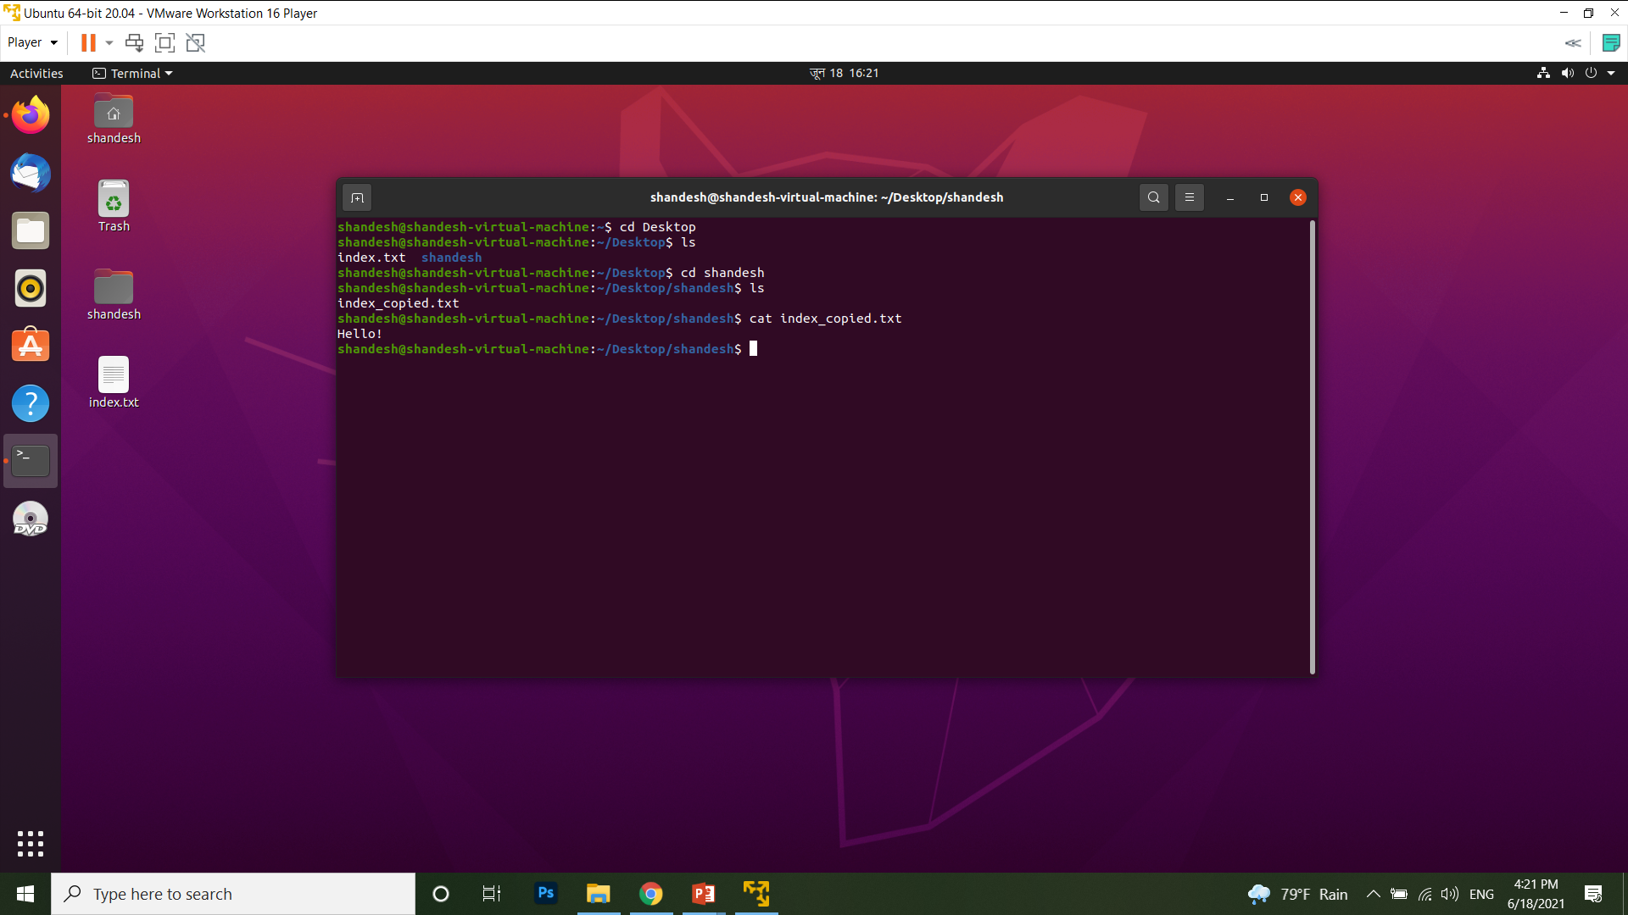

Slide 12


Slide 13
